Slide 1
The Future Of Web
From cloud to edge using server-side components,react 18,next.js13
Thanks to Sir ZIA Khan
Roll no: PIAIC 69976
ISLAMABAD BATCH : 40
By Khuram Hanif

Slide 2
Server-side
Client-side
Comparison b/w server-side and client-side
Cloud computing
Advantages
Disadvantages
Edge computing
Advantages
Applications
Difference b/w cloud computing and edge computing
Edge AI
React js
Features of react js
Next js
Features of Next js
OutLine

Slide 3
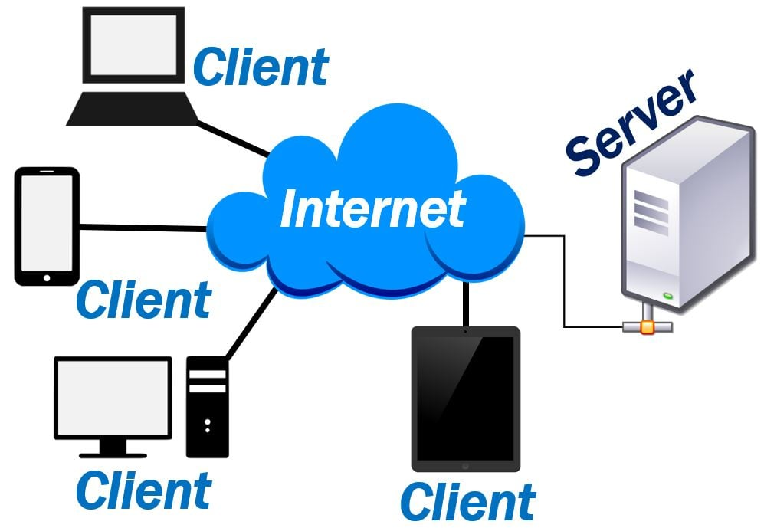
A server is a computer program or device that provides a service to another computer program. In a data center, the physical computer that a server program runs on is also frequently referred to as a server. That machine might be a dedicated server or it might be used for other purposes.
How servers work
The term server can refer to a physical machine, a virtual machine or to software that is performing server services. The way that a server works varies considerably depending on how the word server is being used.
Server

Slide 4

In computing, a client is a piece of computer hardware or software that accesses a service made available by a server as part of the client–server model of computer networks. The server is often on another computer system, in which case the client accesses the service by way of a network.
Client

Slide 5
Server-side VS Client-side
Client-Side
Server-Side
Does not need interaction with the server
Runs on the user’s computer
Reduces load on the server’s processing unit
Languages used: HTML, CSS, JavaScript
Requires interaction with the server
Runs on the web server
Allows the server to provide dynamic websites tailored to the user. Increases the processing load on server.
Languages used: PHP, ASP.net, Python
Comparison
VS

Slide 6
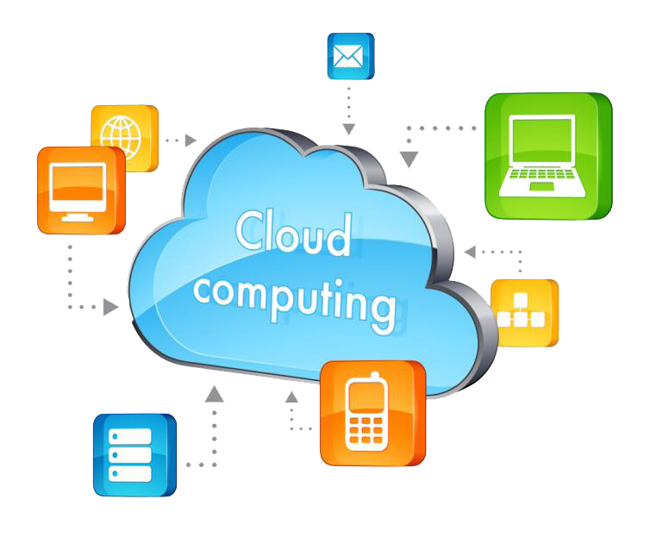
Cloud computing is the delivery of different services through the Internet, including data storage, servers, databases, networking, and software.
Cloud Computing
Cloud computing works
by enabling client
devices to access
data and cloud applications over the internet from remote physical servers, databases and computers

Slide 7
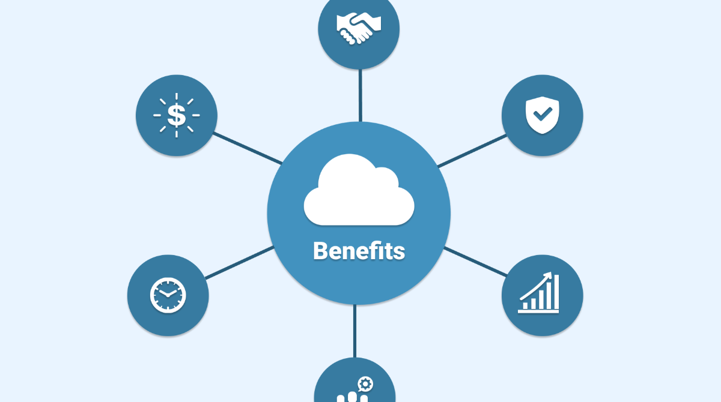
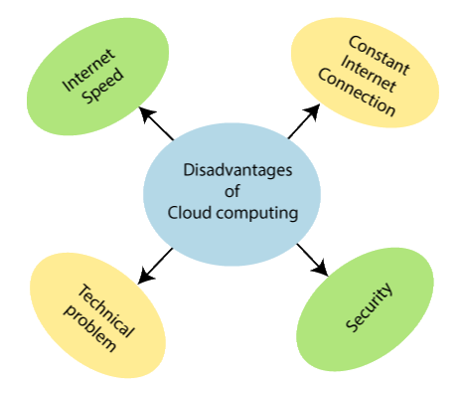
Advantages:
Backup and restore data
Improved collaboration
Excellent accessibility
Low maintenance cost
Unlimited storage capacity
Data security
Pros & cons of Cloud computing
Disadvantages:
Internet Connectivity
Vendor lock-in
Limited Control
Insecure interfaces and APIs.

Slide 8
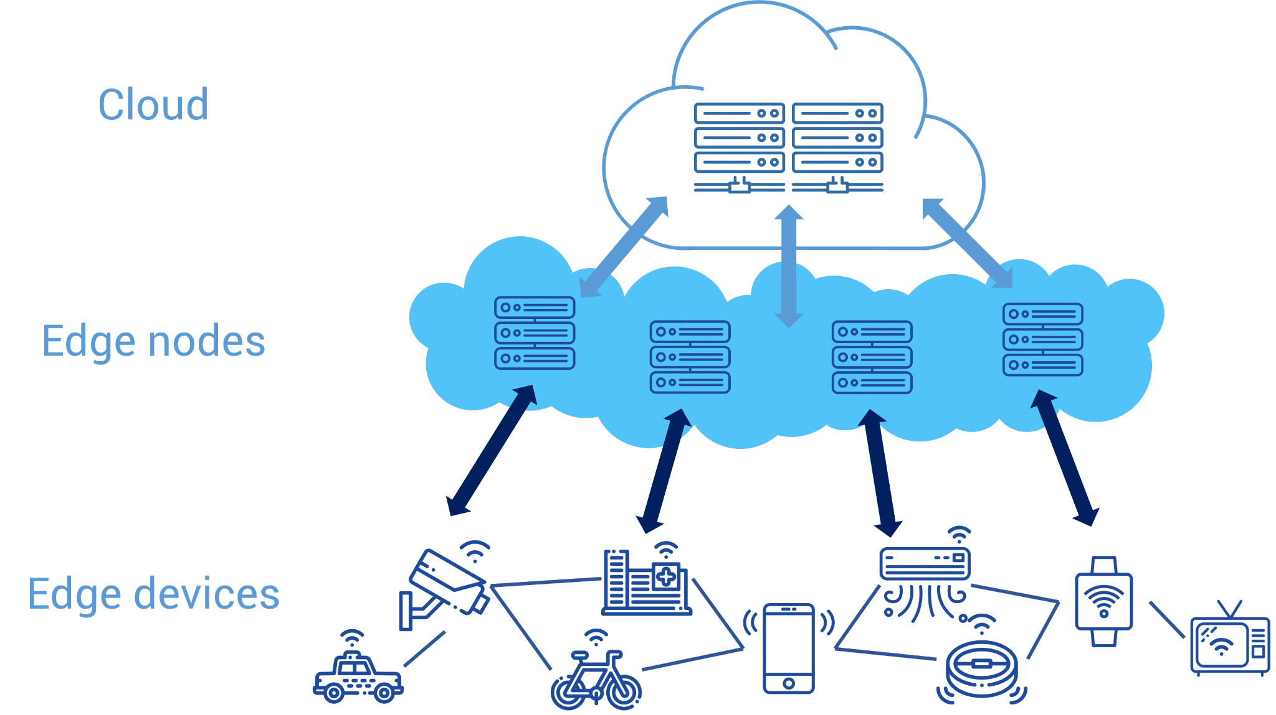
EDGE COMPUTING:
Edge computing is a distributed computing framework that brings enterprise applications closer to data sources such as IoT devices or local edge servers.
This proximity to data at its source can deliver strong business benefits, including faster insights, improved response times and better bandwidth availability.
EDGE COMPUTING
Edge computing can help optimize network performance by measuring performance for users across the internet and then employing analytics to determine the most reliable, low-latency network path for each user's traffic.

Slide 9
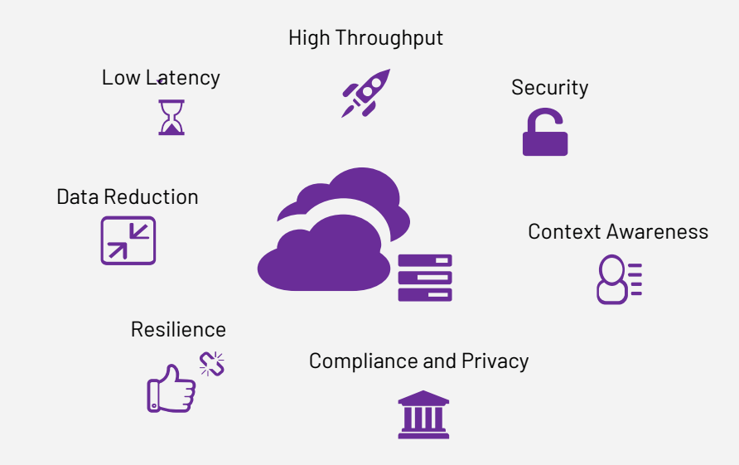
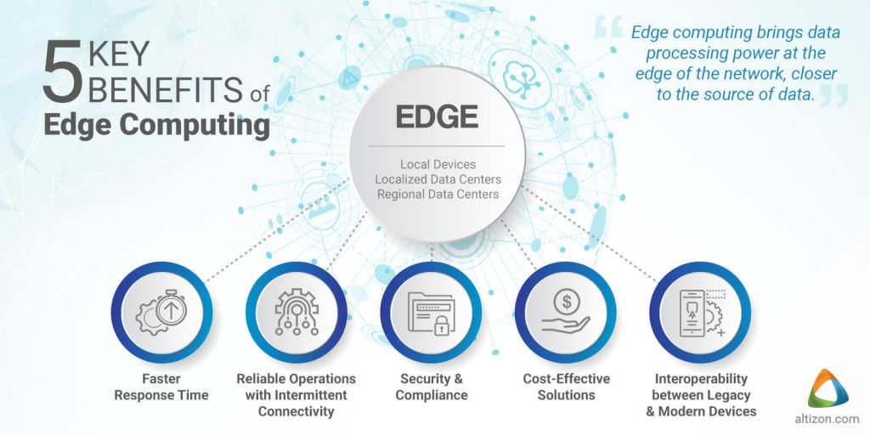
Advantages of Edge computing
Edge computing unlocks benefits like:
Enhanced efficiencies
Minimized latency
Improved security
Increased uptime
Decreased costs
Advantages

Slide 10
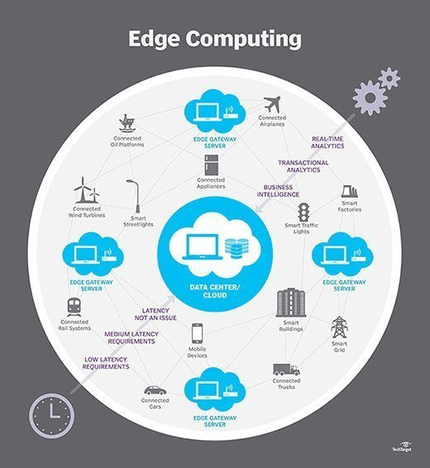
Applications of Edge computing
Autonomous vehicles.
Remote monitoring of assets in the oil and gas industry
Smart grid
Predictive maintenance
In-hospital patient monitoring
Virtualized radio networks and 5G (vRAN)
Cloud gaming
Content delivery.

Slide 11
Points of Disparity | Edge Computing | Cloud Computing
Programming | For development, multiple application programs may be used, all with different running times. | Specific development in clouds is ideally suitable as it is usually made for development environment and utilizes one programming language.
Security | Sophisticated authentication mechanisms and effective attack handling. | It needs less of a comprehensive protection plan.
Relevant organizations | For applications with significant bandwidth problems, Edge Computing is considered as optimal. | For a development program that interacts with huge data processing, Cloud Computing seems to be more fitting.
Advantages | For a new computer; you link to a network, you may individually build up the network. | A huge amount of customizable hosting data can be stored on the web and accessed at any time.
Point of disparity

Slide 12
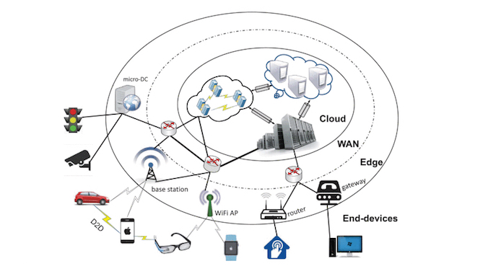
Edge AI is the implementation of artificial intelligence in an edge computing environment. That means AI computations are done at the edge of a given network, usually on the device where the data is created, instead of in a centralized cloud computing facility or offsite data center.
Edge AI
Mostly used in healthcare,self-driving cars and smart home technologies.

Slide 13





REACT JS
React is a free and open-source front-end JavaScript library for building user interfaces based on UI components. It is maintained by Meta and a community of individual developers and companies
React apps developed by using reusable components.These components are assembled to create the final interface with client-side rendering.

Slide 14

Feature of React js
Virtual Document Object Model
React contains a lightweight representation of real DOM in the memory called Virtual DOM. Manipulating real DOM is much slower compared to VDOM as nothing gets drawn on the screen
JSX
By using that, we can write HTML structures in the same file that contains JavaScript code
Components
Building blocks of react app which can be nested and reused
Debugging
Testing React apps is easy due to large community support. Even Facebook provides a small browser extension that makes React debugging easier and faster.

Slide 15

Next js
Next.js is an open-source web development framework created by Vercel enabling React-based web applications with server-side rendering and generating static websites
Where traditional React apps can only render their content in the client-side browser, Next.js extends this functionality to include applications rendered on the server-side.
Next.js supports styling with CSS as well as precompiled Scss and Sass, CSS-in-JS, and styled JSX. In addition, it is built with TypeScript support and smart bundling. The open-source transpiler Babel is used to transform and compile code into JavaScript usable by a browser.

Slide 16

Features of Next Js
Server side rendering (SSR)
Developers can render javascript code on the server which allow them to send html to user.Next js make this rendering possible.
Static Site Generation (SSG)
SSG describes the process of building websites that render at build time. The output is an HTML file, assets such as JavaScript and CSS, and a few other static files. The page is pre-rendered at build-time when using SSG with Next. js
Incremental static regeneration (ISR)
Incremental static regeneration (ISR) is the architecture behind Next. js that allows pages to be updated after a site has been built and deployed. Compared to server-side rendered (SSR) pages and statically-generated pages, ISR pages have distinct advantages.

